Slide 1
My Journey into the Hamara Project
Raju Vindane
Intern @ Hamara Linux
Notes:
Ask people about the concept of IoT?
Tell them about IoT in a nutshell.
How IoT will be implemented?

Slide 3
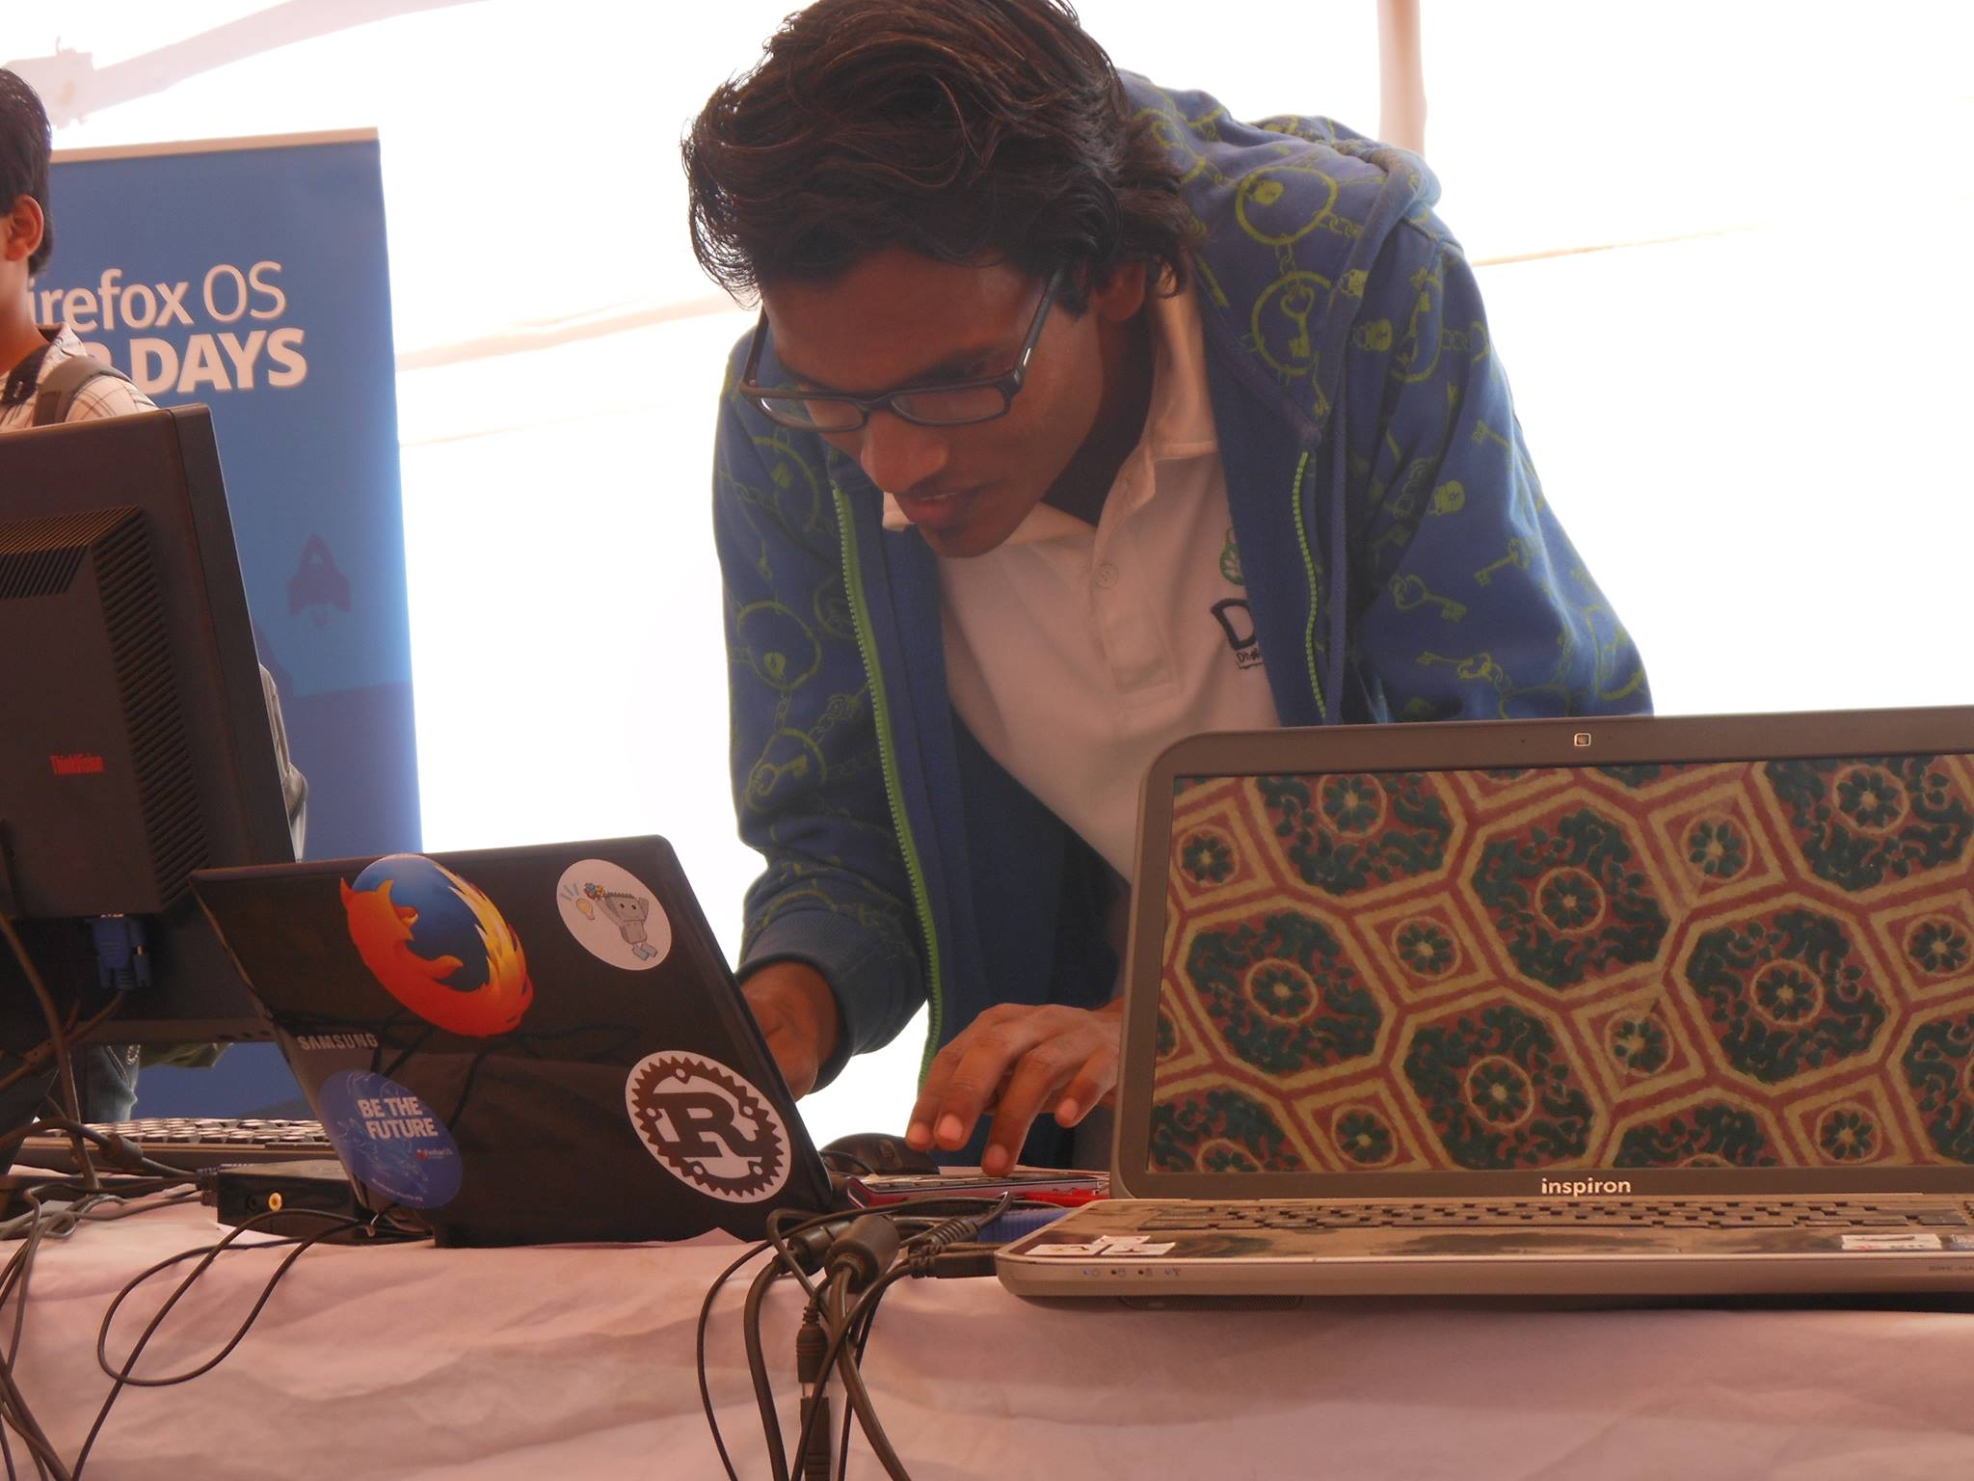
The only passionate Linux user and promoter in the crowd.

Slide 4
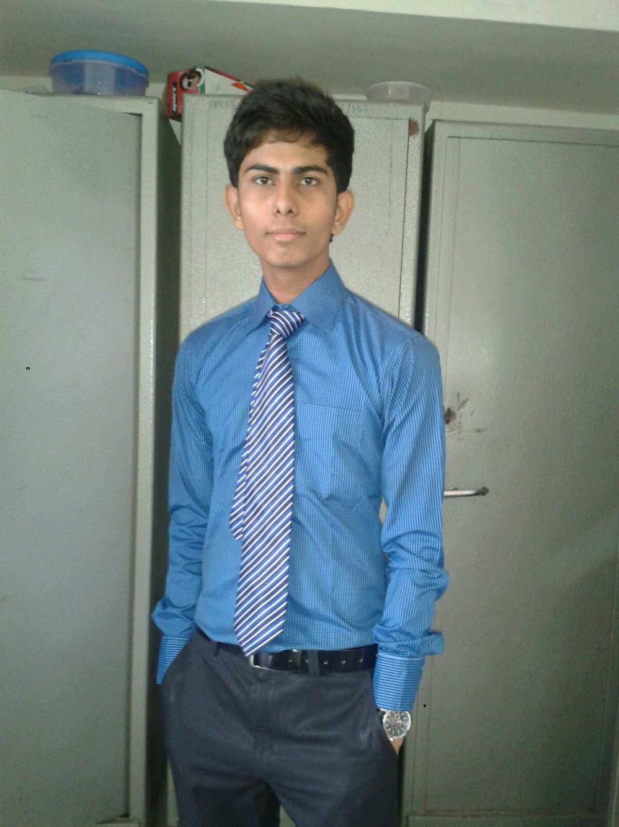
Got some success in the spread of Linux and made a good friend Manish Kumar
Notes:
Open Source Hardware
Telling them some more about the arduino & Rpi

Slide 5
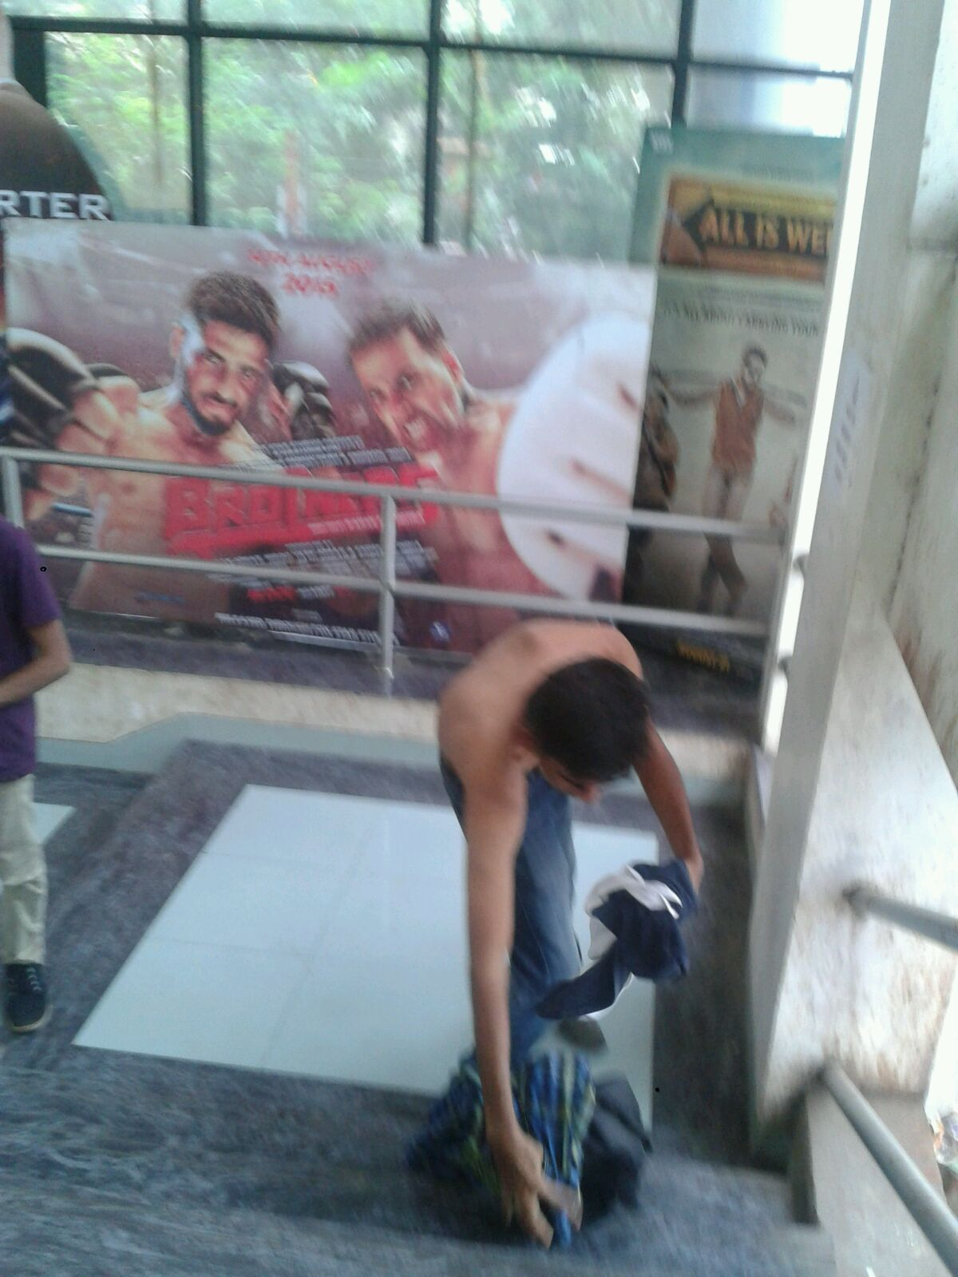
Manish the Akshay Kumar Fan

Slide 6
We got this crazy idea of dedicating a Linux distro to Akki

Slide 7
What will be the name of the Distro?

Slide 8

Khiladi Linux
Notes:
-It is a SBC.
- The Input & Output Devices thing
-

Slide 9
But then it happened

Slide 10
I started working with Fizzible.com as a Linux Trainer, SysAdmin handling up all the technical stuff.
Notes:
-Specifications

Slide 11
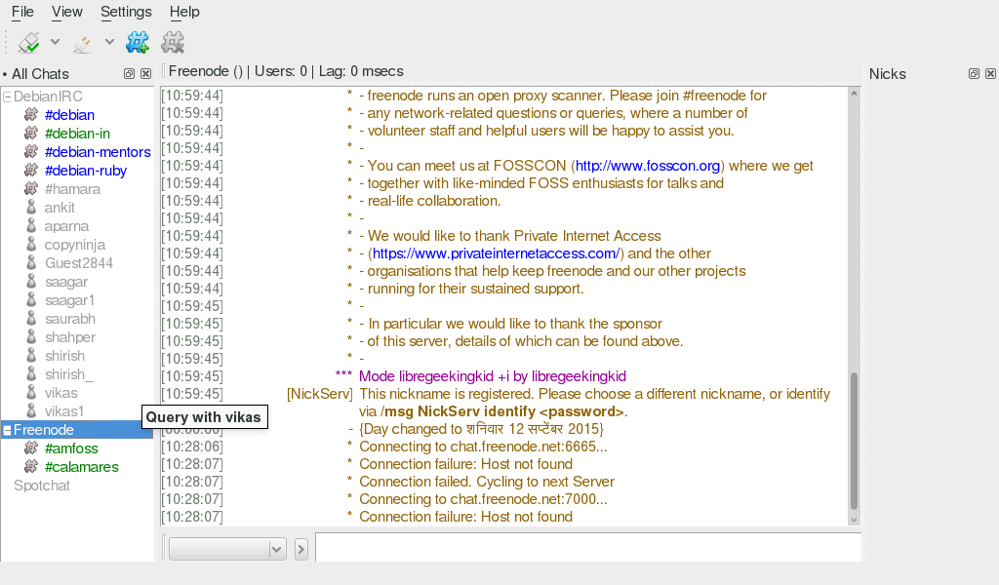
Quassel IRC

Slide 12
The Hamara Conference & the Internship

Slide 13
These people are extremely approachable

Slide 14
I can contribute to Hamara in whatever way I can and make it as friendly to me as I want.

Slide 15
So In future along with the various versions of Hamara GNU/Linux I.e Namaste, Sugam etc.
I will be making a Hamara remixed versioned OS

Slide 16
Hamara Khiladi

Slide 17
DIY

Slide 18
?
Raju Vindane
github.com/rajuvindane
raju@hamaralinux.org
@rajuvindane

